Slide 1
Programming Theory in Python
Different programming concepts/theory and how this is presented in Python

Slide 2
Contents
Variable types and parsing
Variable scope
Functions and procedures (differences)

Slide 3
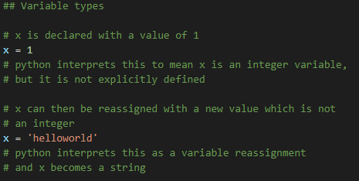
Variable Types
Python is a weakly-typed language. Variables do not have to be declared with an intended type, variables can be reassigned with ease from different types.

Slide 4
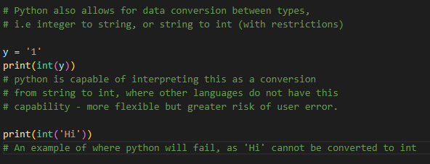
Parsing data between types
As python has weak-typing, certain data can be converted between formats:
Int to string or string to int (where possible)
Bool to int and int to bool (0 or 1)

Slide 5
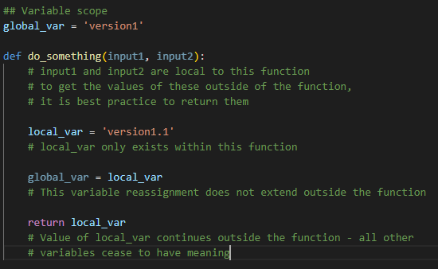
Variable scope
Where a variable is defined will change which parts of a script can access it. E.g. a variable declared within a function is only visible within that function. It is therefore local to that function.
A global variable must be defined in the main body of a script and is then accessible anywhere within the script (changes to variables also have scope, so changes to a global variable within a function only affect that function’s version of the variable)

Slide 6
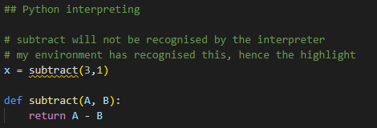
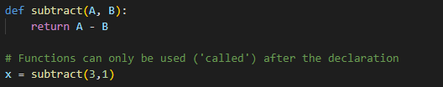
Functions and Procedures
In general, functions and procedures differ in that Functions have associated return values, while Procedures do not.
In python, there is no distinction between the two. A function which is defined may or may not have a return value without the need for a different syntax for declaring the function.
Note: Since python is interpreted line-by-line, function/variable/class declarations must come before they are used, or the interpreter will not recognise what these are.
Incorrect
Correct

